Slide 1
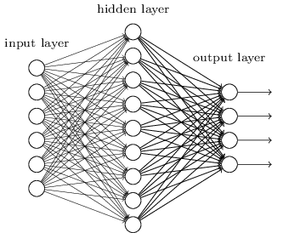
T-sparse Autoencoder
Shallow sparse autoencoder
Only one hidden layer
Encoder and decoder weights can be expressed as a dictionary

Slide 2
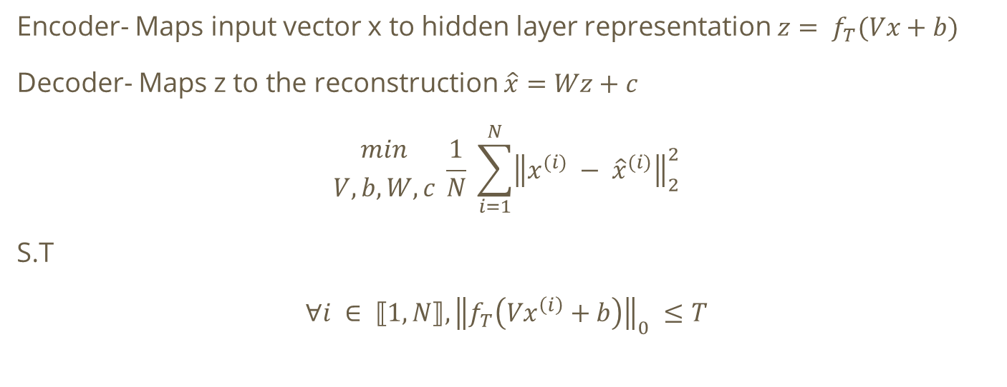
T-sparse Autoencoder
Encoder- Maps input vector x to hidden layer representation $z= f_{T}(Vx+b)$
Decoder- Maps z to the reconstruction $\hat{x}=Wz+c$
$${min \atop V, b, W, c} \frac{1}{N} \sum_{i=1}^{N}{{\left\|x^{(i)} − {\hat{x}}^{(i)}\right\|}_{2}^{2}}$$
S.T
$$∀i ∈ ⟦1, N⟧, {\left\|f_{T}\left(Vx^{\left(i\right)}+b\right)\right\|}_{0} ≤T$$

Slide 3
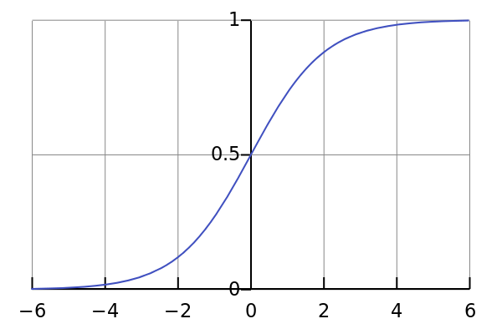
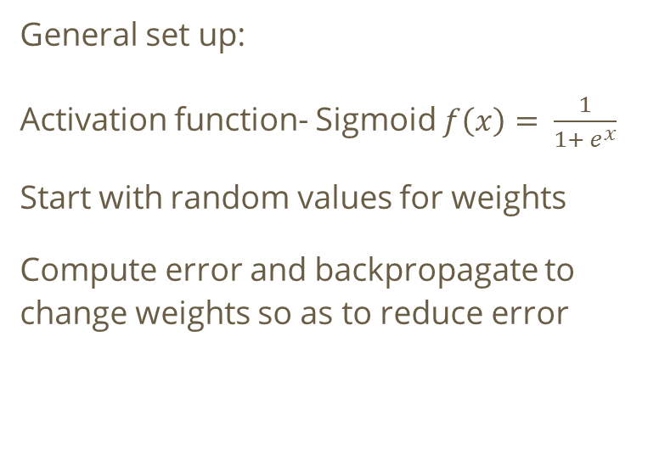
T-sparse Autoencoder
General set up:
Activation function- Sigmoid $f\left(x\right)= \frac{1}{1+ e^{x}}$
Start with random values for weights
Compute error and backpropagate to change weights so as to reduce error

Slide 4
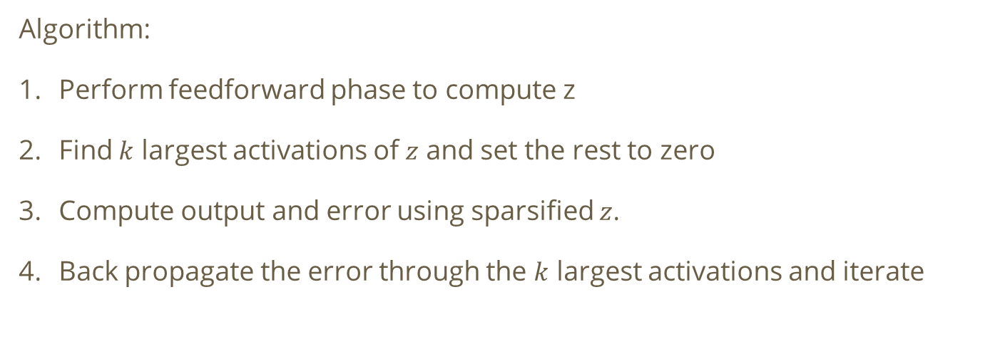
T-sparse Autoencoder
Algorithm:
Perform feedforward phase to compute z
Find $k$ largest activations of $z$ and set the rest to zero
Compute output and error using sparsified $z$.
Back propagate the error through the $k$ largest activations and iterate

Slide 5
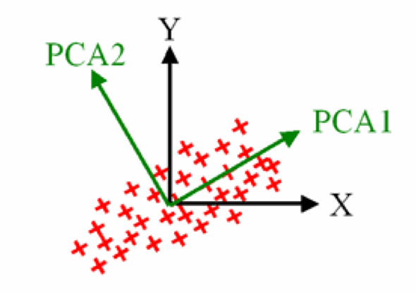
Principal component analysis
Dimensionality reduction technique
Projection of data onto subspace generated by system of orthogonal axes(basis)
Express data as linear combination of these basis

Slide 6
Principal component analysis
The principal components allow for maximum variance in data
For a vector to be a principal component, it must accommodate maximum variance and also be orthogonal to the previous components
The more principal components we add, the more fine grained differences we can record.

Slide 7
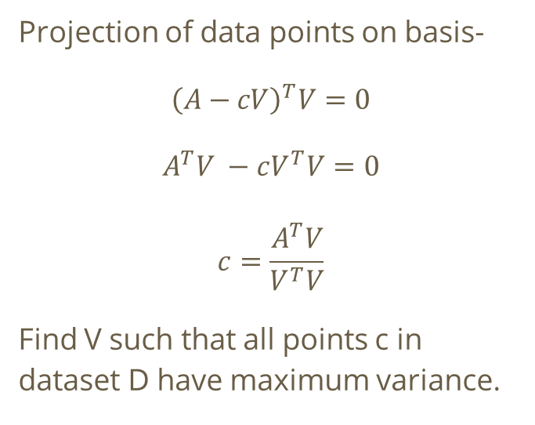
Principal component analysis
Projection of data points on basis-
$${\left(A−cV\right)}^{T}V=0$$
$$A^{T}V −cV^{T}V=0$$
$$c=\frac{A^{T}V}{V^{T}V}$$
Find V such that all points c in dataset D have maximum variance.
A
(A – c.V)
c.V
V

Slide 8
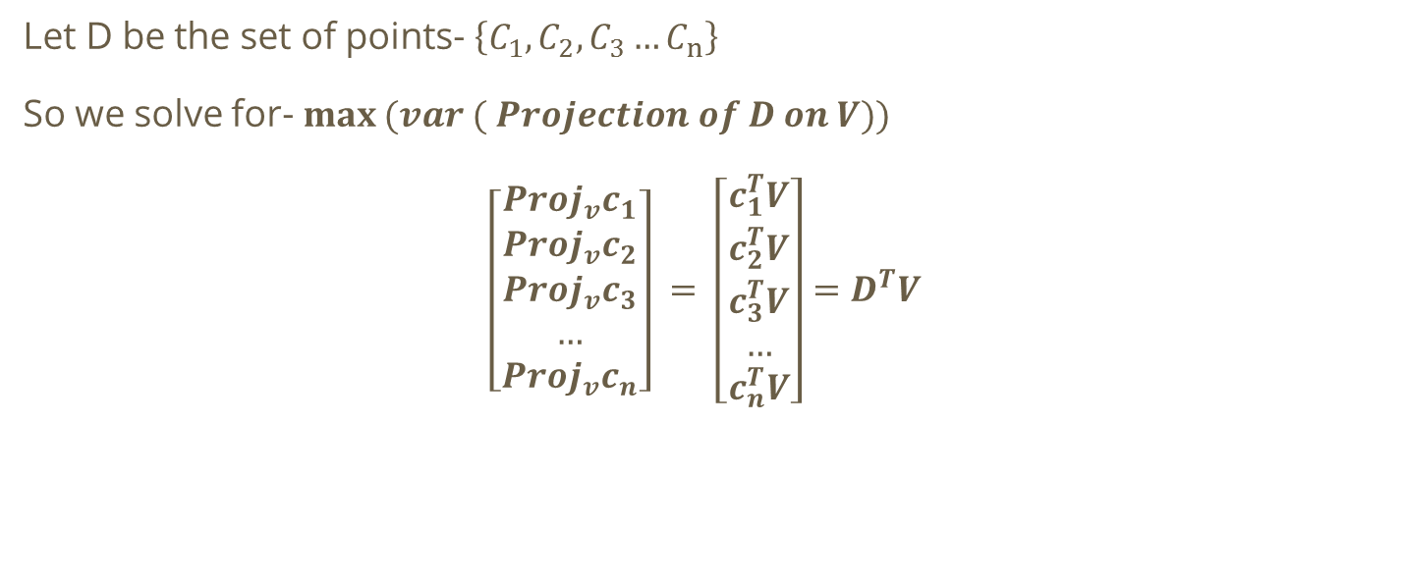
Principal component analysis
Let D be the set of points- $\left\{C_{1}, C_{2}, C_{3}…C_{n}\right\}$
So we solve for- $\max{(var ( Projection of D on V))}$
$$\left[\begin{aligned}{Proj}_{v}c_{1} \\ {Proj}_{v}c_{2} \\ {Proj}_{v}c_{3} \\ … \\ {Proj}_{v}c_{n}\end{aligned}\right] = \left[\begin{aligned}c_{1}^{T}V \\ c_{2}^{T}V \\ c_{3}^{T}V \\ … \\ c_{n}^{T}V\end{aligned}\right]=D^{T}V$$

Slide 9
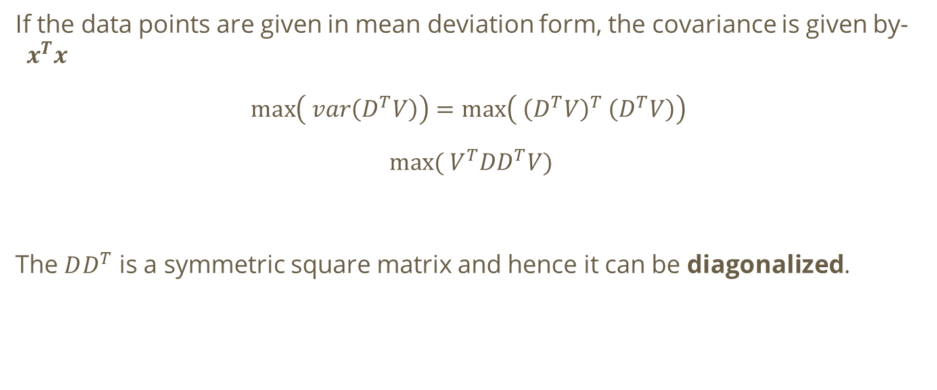
Principal component analysis
If the data points are given in mean deviation form, the covariance is given by-$x^{T}x$
$$\max\left( var\left(D^{T}V\right)\right)=\max\left( {\left(D^{T}V\right)}^{T} \left(D^{T}V\right)\right)$$
$$max⁡( V^{T}DD^{T}V)$$
The $DD^{T}$ is a symmetric square matrix and hence it can be diagonalized.

Slide 10
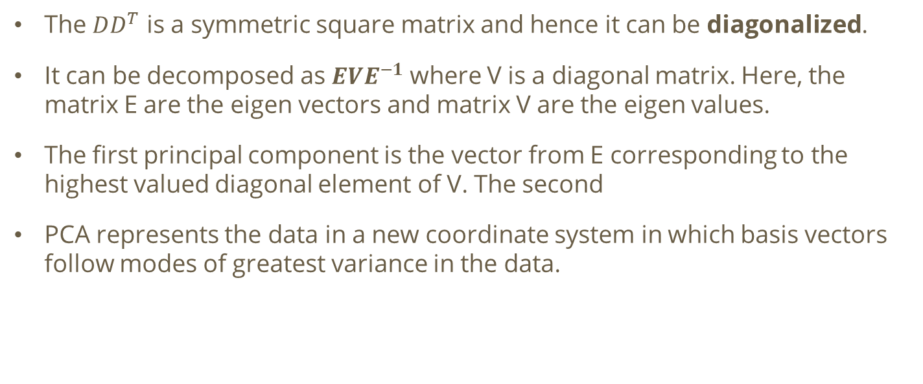
Principal component analysis
The $DD^{T}$ is a symmetric square matrix and hence it can be diagonalized.
It can be decomposed as $EVE^{−1}$ where V is a diagonal matrix. Here, the matrix E are the eigen vectors and matrix V are the eigen values.
The first principal component is the vector from E corresponding to the highest valued diagonal element of V. The second
PCA represents the data in a new coordinate system in which basis vectors follow modes of greatest variance in the data.

Slide 11
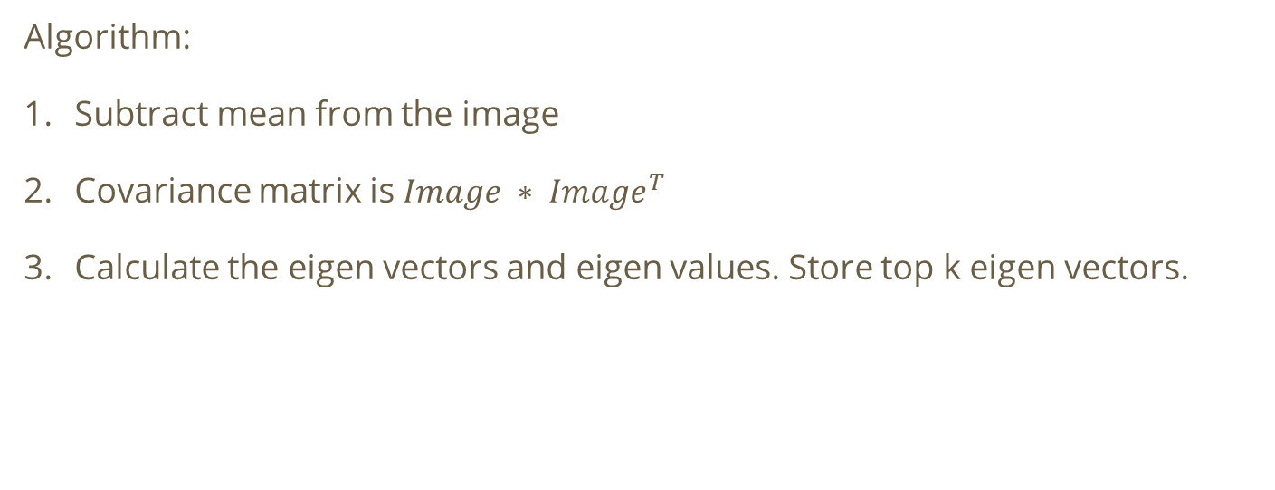
Principal component analysis
Algorithm:
Subtract mean from the image
Covariance matrix is $Image ∗ {Image}^{T}$
Calculate the eigen vectors and eigen values. Store top k eigen vectors.

Slide 12
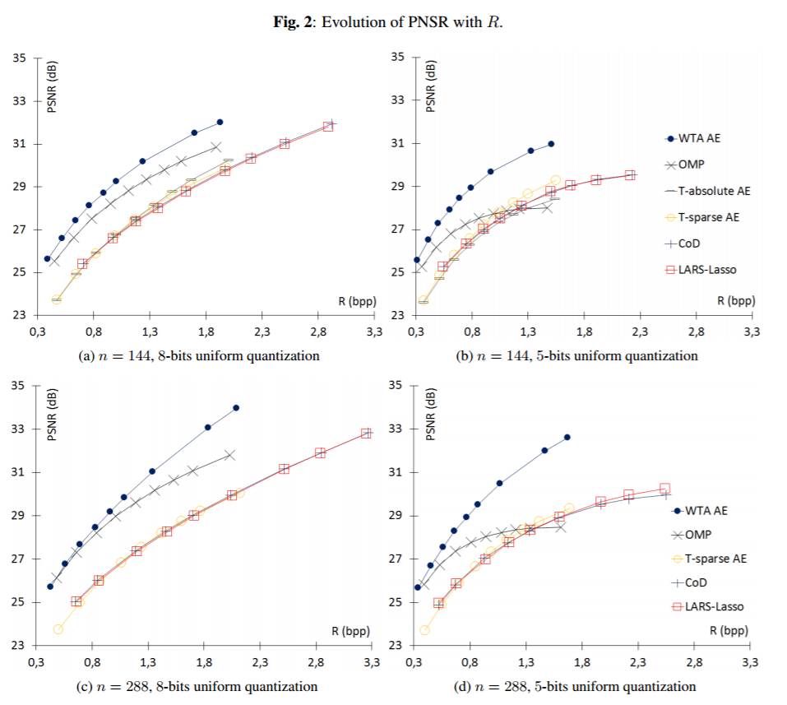
Conclusion

